Slide 1
Public Key Infrastructure

Slide 2
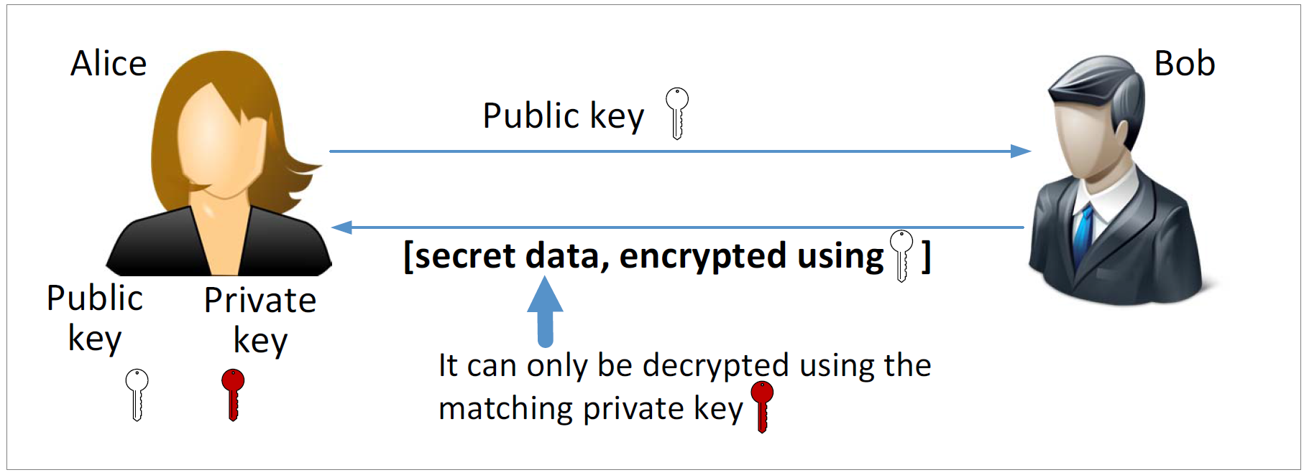
Public Key Cryptography
Notes:
Giving Alice’s public key to Bob allows Bob to send secret data to Alice, because Bob can encrypt it using Alice’s public-key. However, is this really secure?

Slide 3
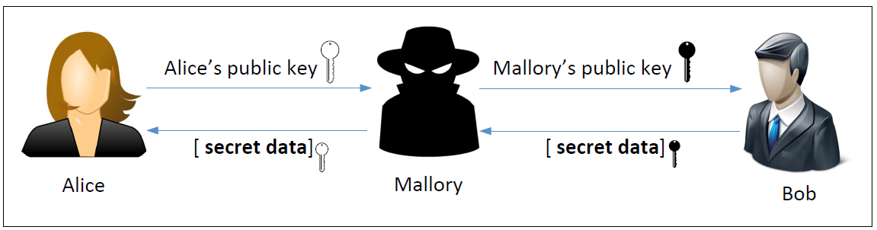
Man-in-the-Middle (MITM) Attack
Notes:
Problem: how can Bob be sure that the public-key is coming from Alice? The Internet can be sniffed and changed by attacker easily. This is called the man-in-the-middle attack. Attacker Mallory can pretend to be Bob when talking to Alice and pretend to be Alice when talking to Bob.

Slide 4
What Is the Fundamental Problem?
Fundamental Problem: Bob has no way to tell whether the public key he has received belongs to Alice or not.
Solution:
Find a trusted party to verify the identity of Alice (e.g., check Driver’s license of Alice).
Issue a certificate: this public-key belongs to Alice.
the certificate should be unforgeable (a good digital signature works)
Notes:
The fundamental issue here is that Bob has no way to verify whether the received public-key belongs to Alice or not.
If some well-known person can generate a proof that this public-key belongs to Alice, then Bob will be convinced. This is the idea of public-key certificate.

Slide 5
Defeating MITM Attacks using Digital Signature
Alice needs to go to a trusted party to get a certificate.
After verifying Alice’s identity, the trusted party issues a certificate with Alice’s name and her public key.
Alice sends the entire certificate to Bob.
Bob verifies the certificate using the trusted party’s public key.
Bob now confirms the true owner of a public key is Alice.
If an attacker replaces the public-key with his own and claims it is Alice’s public-key, Bob will not accept because attacker can not provide a certificate binding Alice and this modified public-key.
Notes:
Return to the man-in-the-middle attack problem between Alice and Bob. The above procedure shows how this attack is no longer working, if Alice sends her public-key certificate to Bob.

Slide 6
Certificate Authority (CA): a trusted party who verifies the public key is owned by an ID (such as www. uwindsor.ca), provide a proof about this (i.e., sign on (PK_uw, www.uwindsor.ca)).
Digital Certificate: The proof described above.
X.509 standard: the standard to generate the certificate
Notes:
Certificate Authority (CA) is the entity providing the certificate service.
The standard certiticate format is to use x.509. In our certificate experiment, you will practice how this can be done.

Slide 7
Verify a public-key certificate
Certificate is a signature by CA.
We need to know CA’s public-key in order to verify this certificate.
CA’s public-key is presented in its own certificate.
This certificate could be provided by this CA itself.
That is, CA’s certificate is a signature by itself.
This type of CA is called root CA.
Notes:
To verify a certificate, we need the issuer (i.e., CA) public-key. This CA’s public-key is presented in its own certificate.

Slide 8
Root CA and Digital Certificate
Why do we trust root CA’s certificate is authentic (not fake)?
They are famous and this type of certificate has already be saved
in your computer at the time of your computer installation.
To see an example of such certificate, go to /etc/ssl/certs
view one of the file (ex: WoSign.pem) using x509:
openssl x509 –in WoSign.pem –text -noout
Notes:
In our experiment, you will play as a root CA to issue certificates.
The best-known root certificates are distributed in operating systems by their manufacturers. Microsoft distributes root certificates belonging to members of the Microsoft Root Certificate Program to Windows desktops and Windows Phone 8. Apple distributes root certificates belonging to members of its own root program.

Slide 9
Verify a certificate not provided by root CA
Sometimes, a certificate is not issued by a root CA.
In this case the server can provide a list of certificates such as
cert_pk, cert_CA1, cert_CA2, .., cert_CA5, cert_rootCA
cert_pk: proof that pk belongs to its owner (e.g., Alice), provided by CA1
cert_CA1: proof that pubkey in this cert belongs to CA1, provided by CA2
cert_CA2: proof that pubkey in this cert belongs to CA2, provided by CA3
…
cert_CA5: proof that pubkey in this cert belongs to CA5, provided by rootCA
cert_rootCA: proof that pubkey in this cert belongs to rootCA, provided by itself
cert_rootCA is in your computer (can be removed from the above cert list).

Slide 10
Transport Layer Security

Slide 11
Overview of TLS
Transport Layer Security (TLS) is a protocol that provides a secure channel between two communicating applications. The secure channel has 3 properties:
Confidentiality: Attacker should not be able to understand the message sent over the channel.
Integrity: Channel can detect any changes to the data in the transmission
Authentication: This is to confirm the identity of one communicant. If Alice is authenticated, then no one else can pretend to be Alice.
Notes:
TLS evolved from the older version SSL and is gradually replacing SSL
When SSL was standardized by IETF, it was renamed to TLS
SSL version 3.0 was deprecated and replaced by TLS in June 2015
TLS is designed to run on top of TCP but can be implemented with other protocols such as UDP

Slide 12
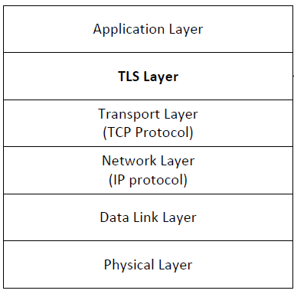
TLS Layer
TLS sits between the Transport and Application layer
Unprotected data is given to TLS by Application layer
TLS handles encryption, decryption and integrity checks
TLS gives protected data to Transport layer
Notes:
Application will use TLS_socket.send(msg) to send message.
TLS will take msg from application and do encryption and integrity operations.
After this, a ciphertext of msg is computed. TLS then sends using TCP_socket.send(ciphertext)
At receiver side, TLS will verifies the integrity of ciphertext and decrypt it to msg. Finally, it gives to application which will be received via TLS_socket.recv().

Slide 13
TLS Handshake
Before a client and server can communicate securely, several things need to be set up first:
Encryption algorithm and key
MAC algorithm
Algorithm for key exchange
These cryptographic parameters need to be agreed upon by the client and server
This is the primary purpose of the handshake protocol
Notes:
In the previous slide, we did not mention how the encryption key is shared between client and server, what algorithm for encryption and integrity will be used
All these will be done in the TLS Handshake protocol. Imagine that TCP connection will run 3-way handshake protocol to set up the connection as well as its parameters such as receive window. TLS handshake protocol has the similar purpose.

Slide 14
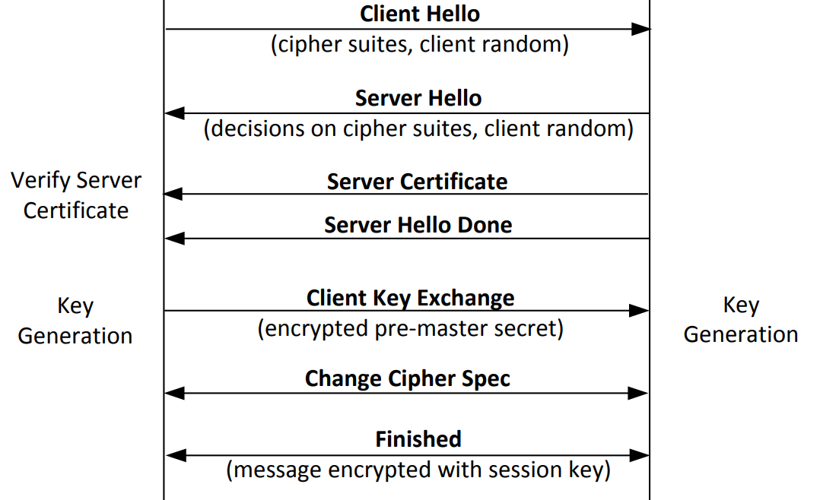
TLS Handshake Protocol
Notes:
Ciphert suites: the possible encryption algorithms (such as RSA, AES, MD5, SHA2). Client-server will need to agree on what algorithms will be used. Client hello asks this to server and server makes decision on server hello.
Client random: a random number chosen by client. This random will always be put into the encryption and integrity operation so that the ciphertext is different from old one (so attacker can not use older ciphertext to cheat the receiver).
Server certificate: server will provide his public-key certificate to client. This will be verified as mentioned before.
Client key exchange: this will be key exchange between client and server so that they will share a secret key.

Slide 15
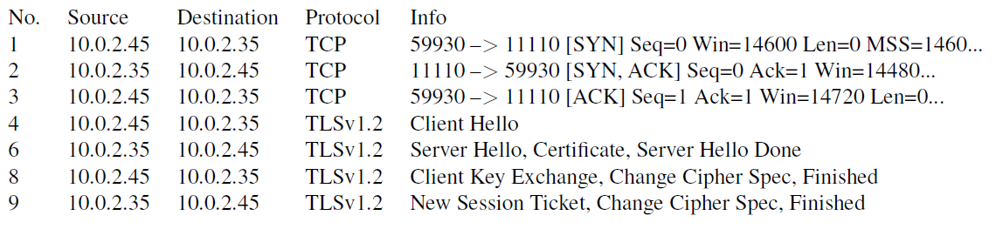
Network Traffics During TLS Handshake
Since TLS runs top of TCP, a TCP connection needs to be established before the handshake protocol. This is how the packet exchange looks between a client and server during a TLS handshake protocol captured using Wireshark:
Notes:
TLS runs on top of TCP. So before TLS, TCP connection should be established.

Slide 16
Certificate Verification
Certificate is a signature from an authority (e.g., VeriSign): the public key (e.g., RSA public key) belongs to the hostname or ip address.
The client first does a validation check of the certificate
Check expiration date, signature validity, etc.
Hostname and certificate’s common name match
Cert verification is discussed before. Especially, the server could send a list of certificates to client with one of them signed by root CA.
Notes:
When client receives the certificate, it will verify it as mentioned before.
In addition, client will verify that the hostname it wants to talk with is the same as that carried in the certificate.

Slide 17
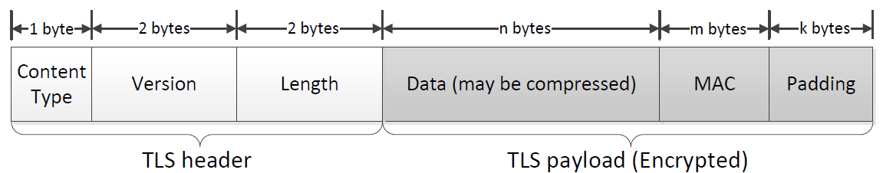
TLS Data Transmission
Once the handshake protocol is finished, client and server can start exchanging data.
Data is transferred using records.
Each record contains a header and a payload
Notes:
In this section, we focus on the application record type, which is used to transfer application data between a client and a server
Content Type: Indicates the type of protocol data carried by current record (handshake, alert, application, heartbeat or ChangeCipherSpec)
Version: This field identifies major and minor version of TLS being used
Length: The length of the payload field.

Slide 18
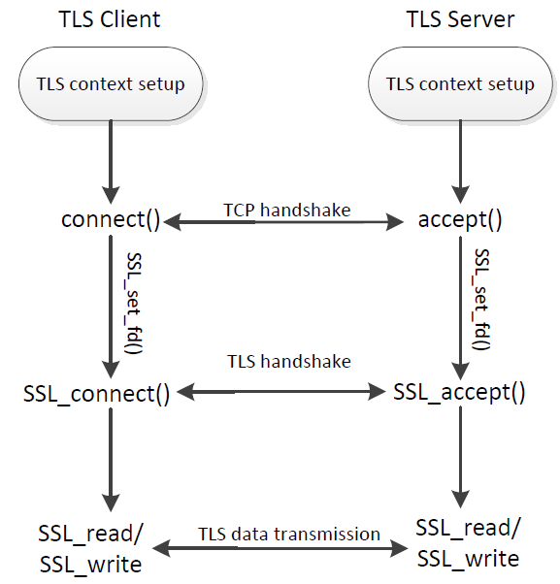
TLS Programming : Overall Picture

Slide 19
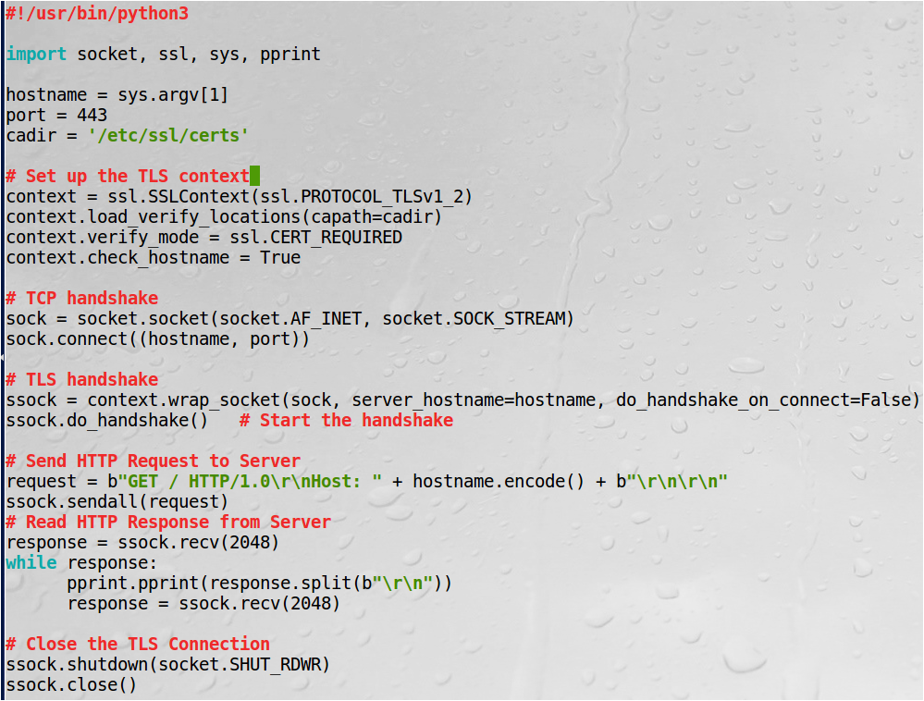
Python TLS Client Program
Test: $ python3 client.py www.google.com You will received the initial get response.
Notes:
cadir: it is the location you store CA certificates (recall CA’s public-key will be used to verify the server public-key certificate).
ssl.CERT_REQUIRED: need to verify server certificate
check_hostname: need to check sys.argv[1] is the same as the owner carried in server certificate.

Slide 20
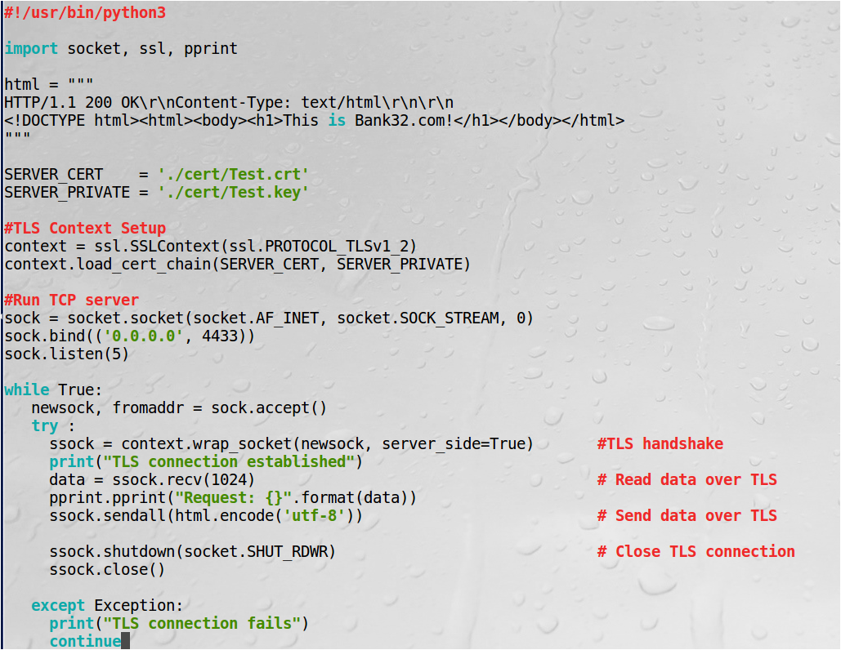
Python TLS Server Program
Follow reference file to create and use certificate and key.
$ python3 server.py
run client.py (with port 4433) on another VM to test client and server communication
$python3 client.py 10.0.2.4
10.0.2.4 is th server ip.

